Slide 1
Importance of Algorithm Analysis
Prof. Joarder Ph.D.
Institute of Information Technology
University of Dhaka

Slide 2
Introduction to Analysis of Algorithms
Study of an algorithm’s performance based on time and memory space consumption.
The algorithm taking least time and memory space is preferred.
Two ways to analyze an algorithm:
Priori Analysis
Posteriori Analysis

Slide 3
Priori vs. Posteriori Analysis
Priori Analysis | Posteriori Analysis
1. Estimation of time and memory space required by an algorithm before executing it on the system. 2. Independent of the programming language. 3. Independent of the hardware | 1. Calculation of time and memory space required by an algorithm after executing it on the system. 2. Dependent of the programming language. 3. Dependent on the hardware.

Slide 4
Importance of Algorithm Analysis
There are many algorithms to solve a problem.
Requirement is to find the most efficient algorithm to solve the problem.
Efficiency in terms of time and memory space consumption

Slide 5
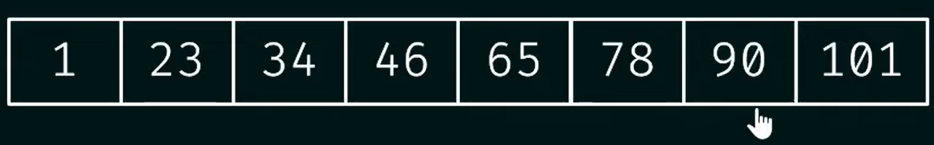
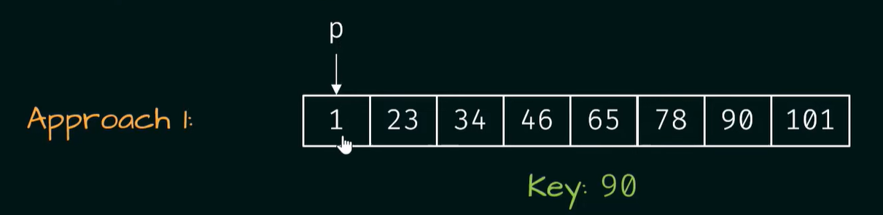
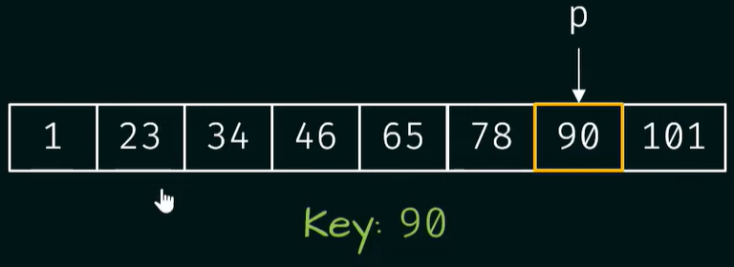
Example –Finding the key
Total Comparison=07

Slide 6
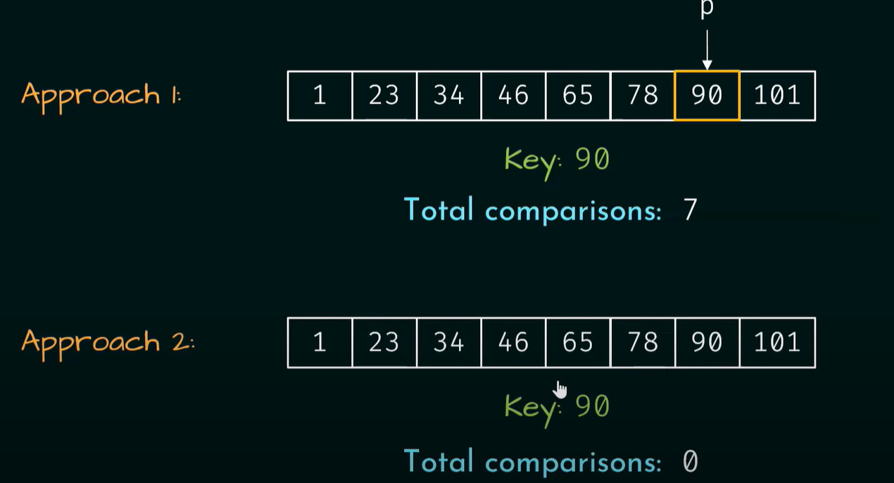

Slide 7
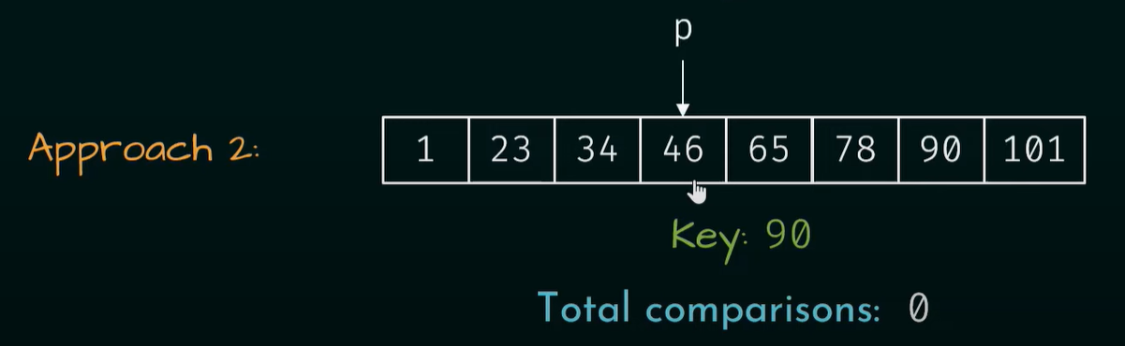
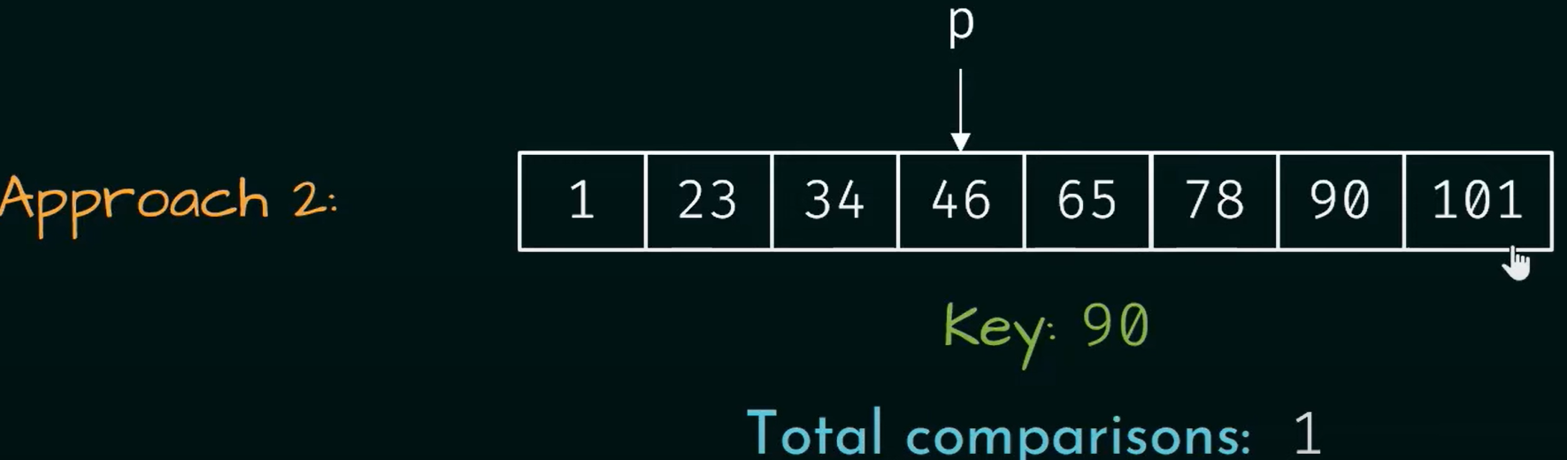

Slide 8
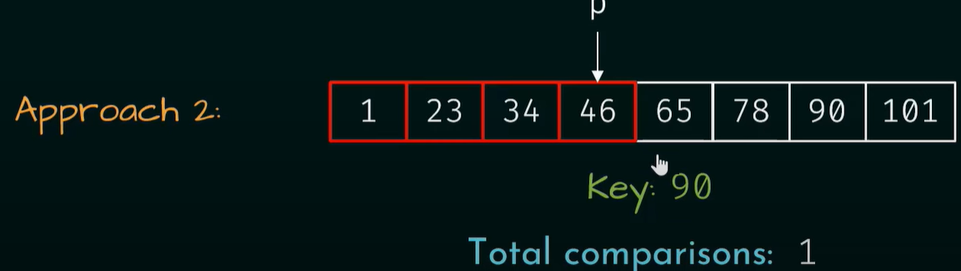
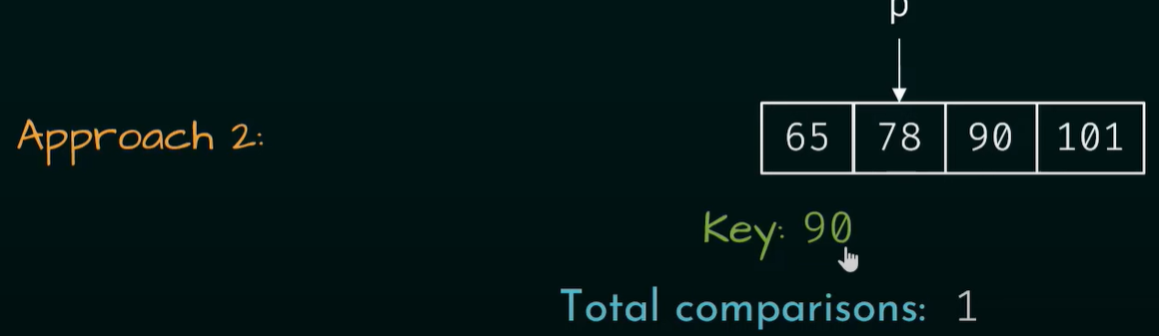

Slide 9
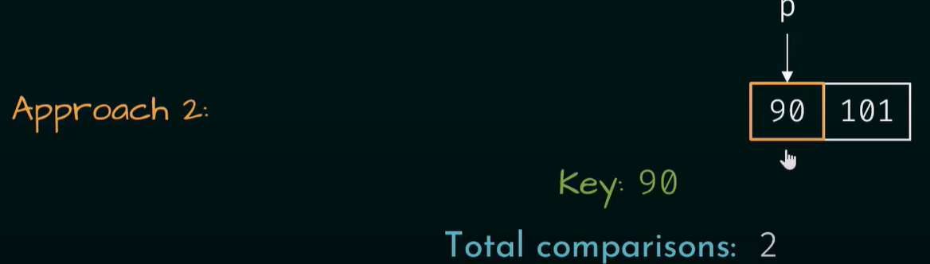

Slide 10
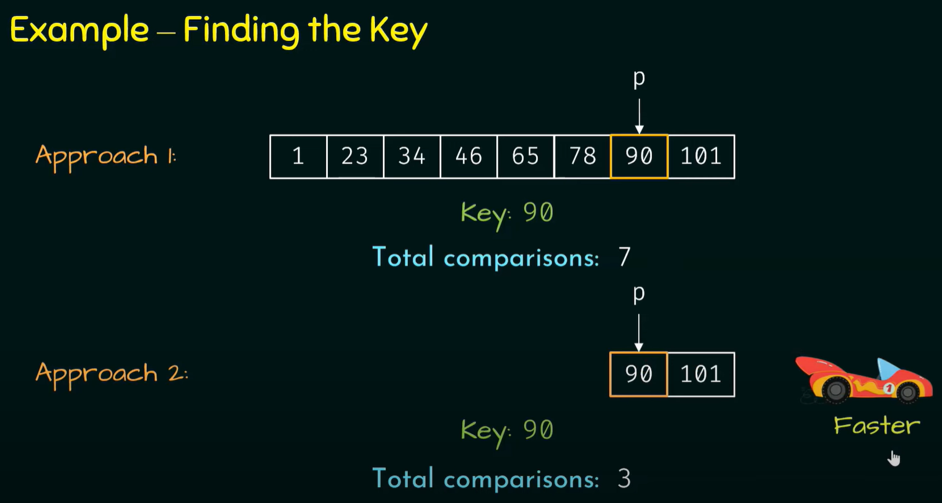

Slide 11
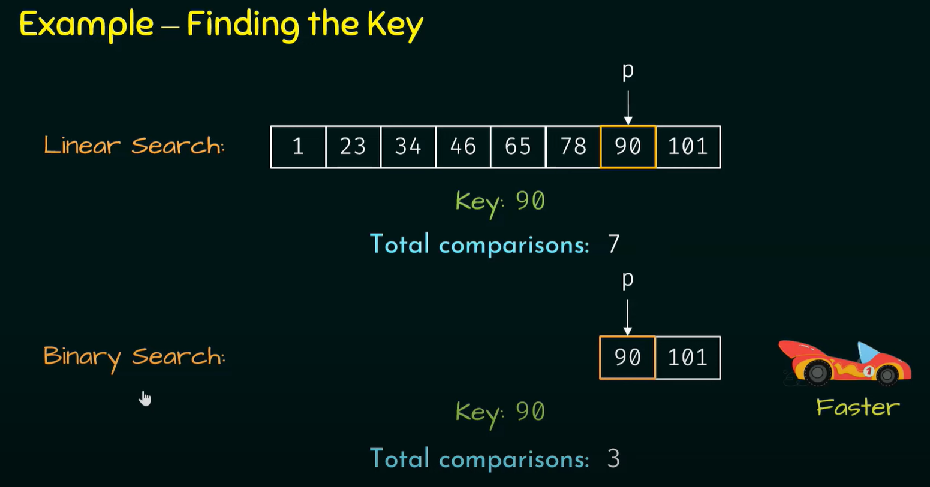

Slide 12
Example-Finding the key
For 100 integers,
Linear Search: 100 comparisons
Binary Search: 7comparisons

Slide 13
Importance of Growth Rate
Linear Search | Binary Search
100 items 100 comparisons(100 ms) | 100 items 7 comparisons(7 ms)
1 billion items 1billion comparisons(11 days) | 1 billion items 30 comparisons(30 ms)

Slide 14
Importance of Growth Rate
As the size of the input grows, speed of the binary search grows drastically.
One example is not enough to analyze algorithms.
Important to know how fast an algorithm grows w.r.t the input size.
Definition:
Rate at which running time increases as a function of input is called the growth rate.
Can be measured using the Big O Notation

Slide 15
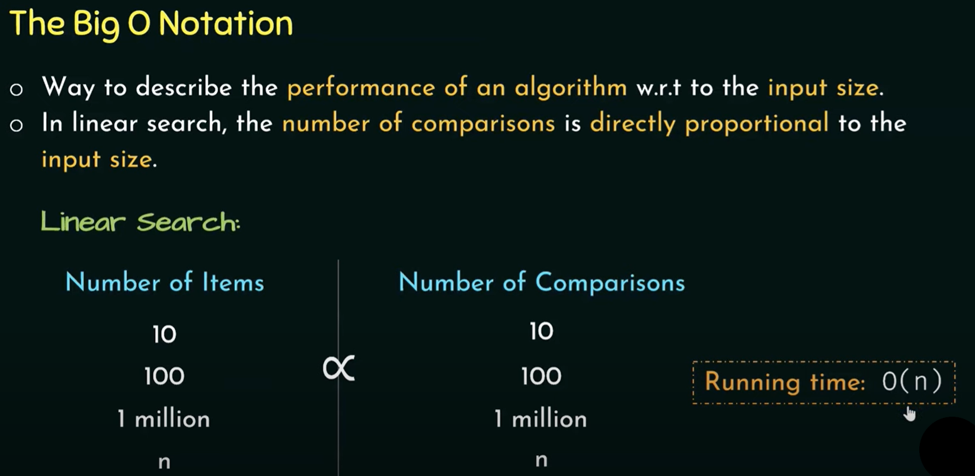

Slide 16
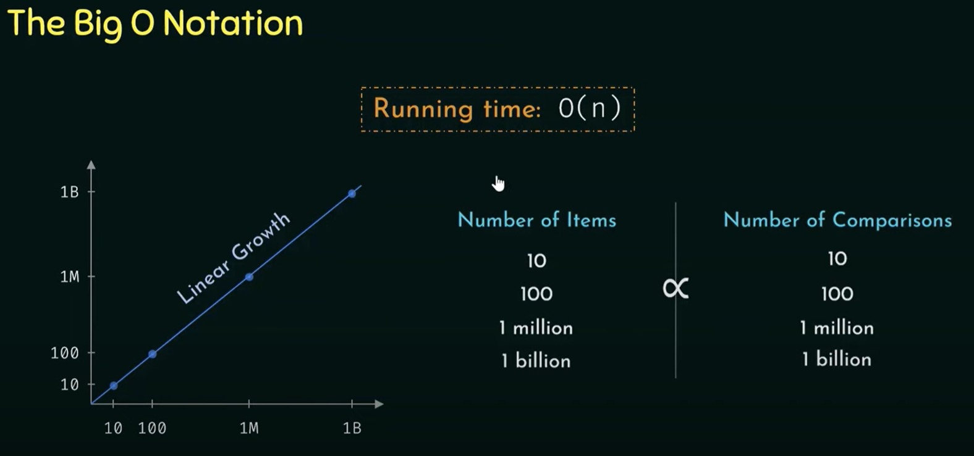

Slide 17
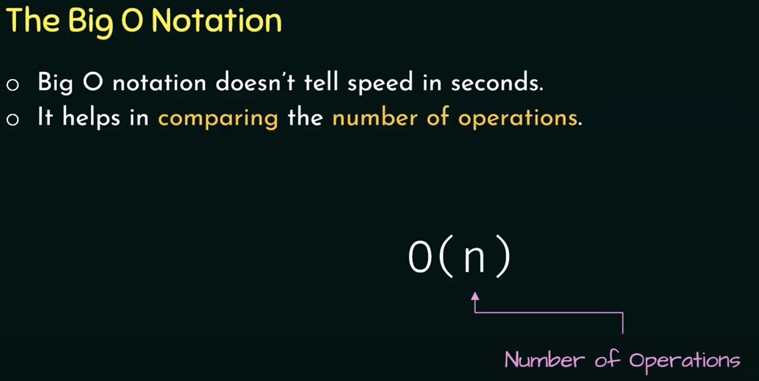

Slide 18
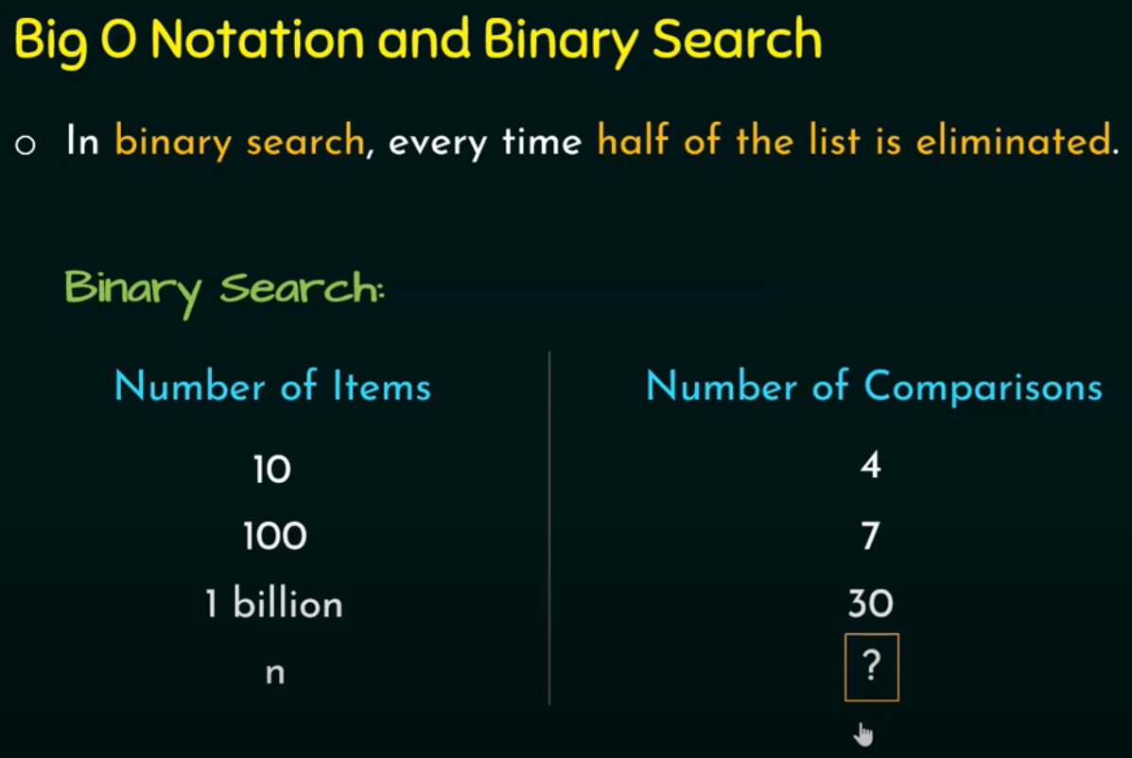

Slide 19
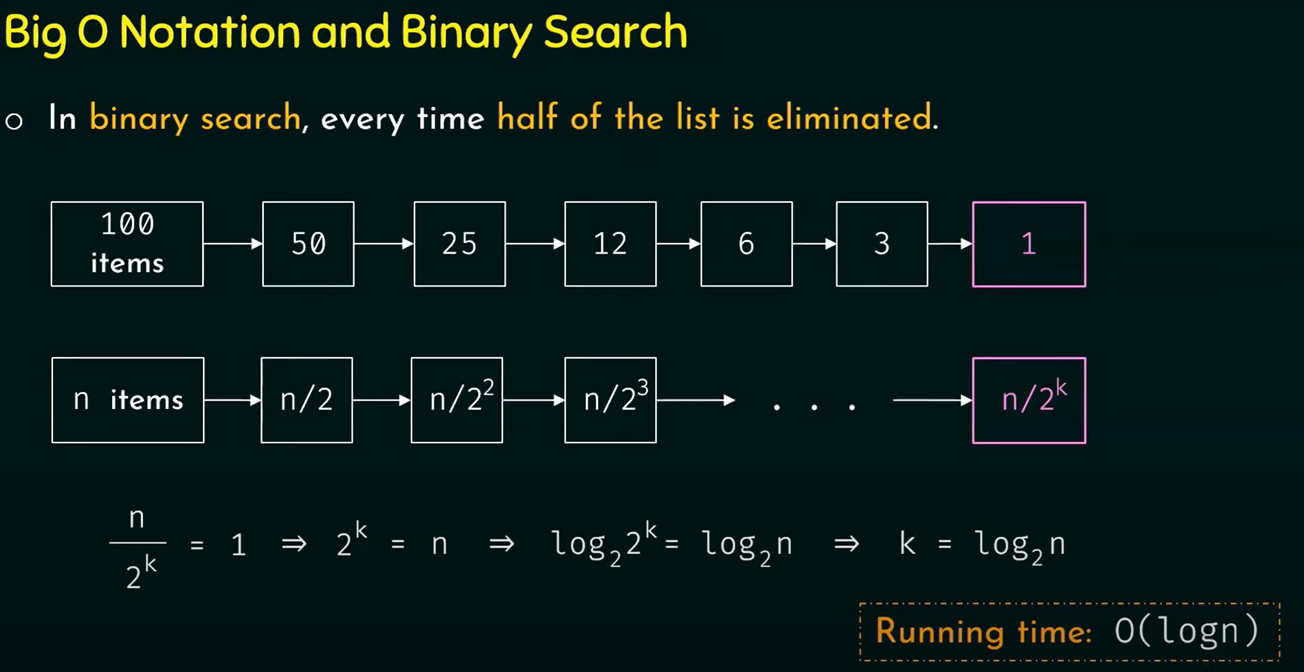

Slide 20
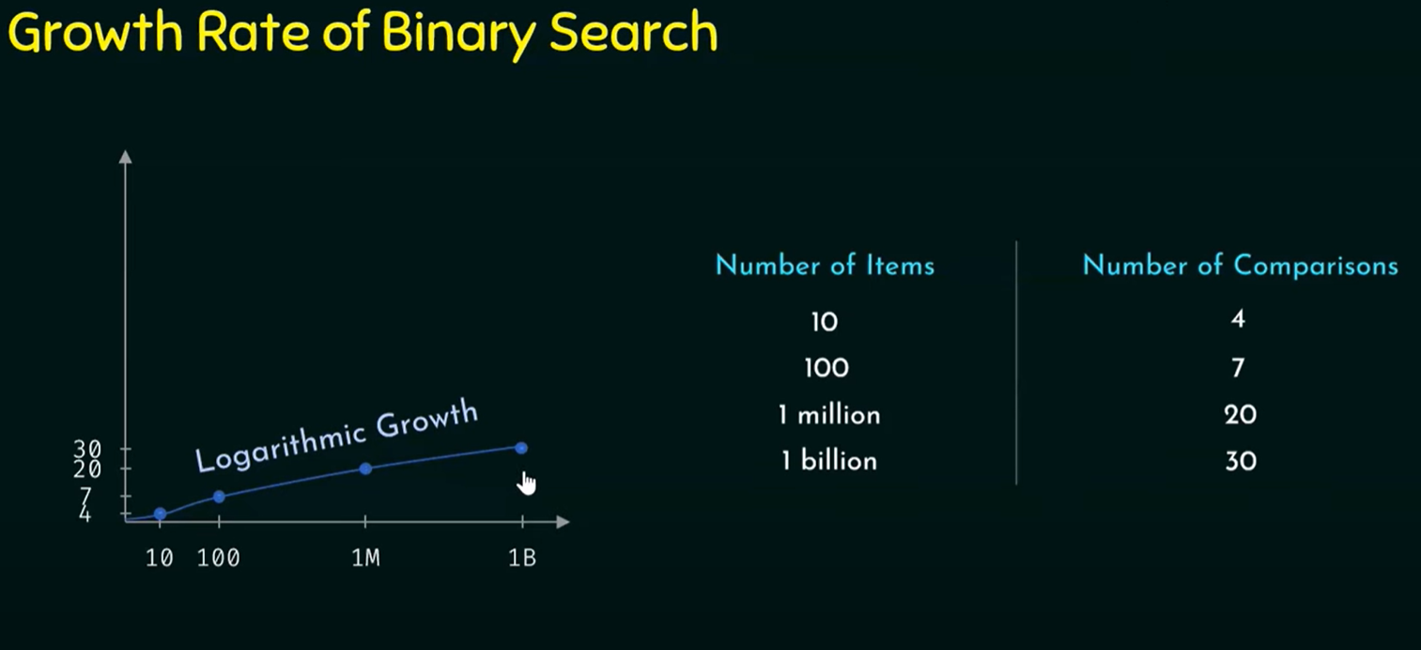

Slide 21
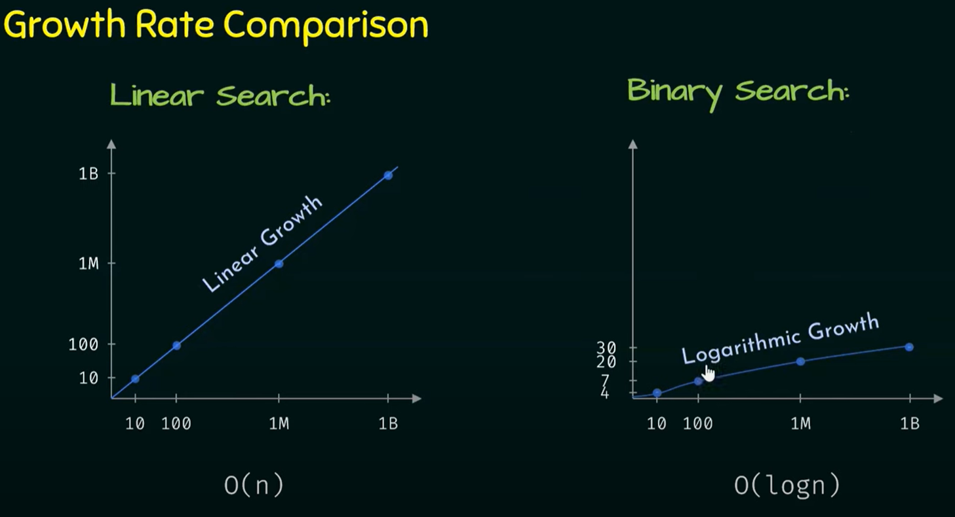

Slide 22
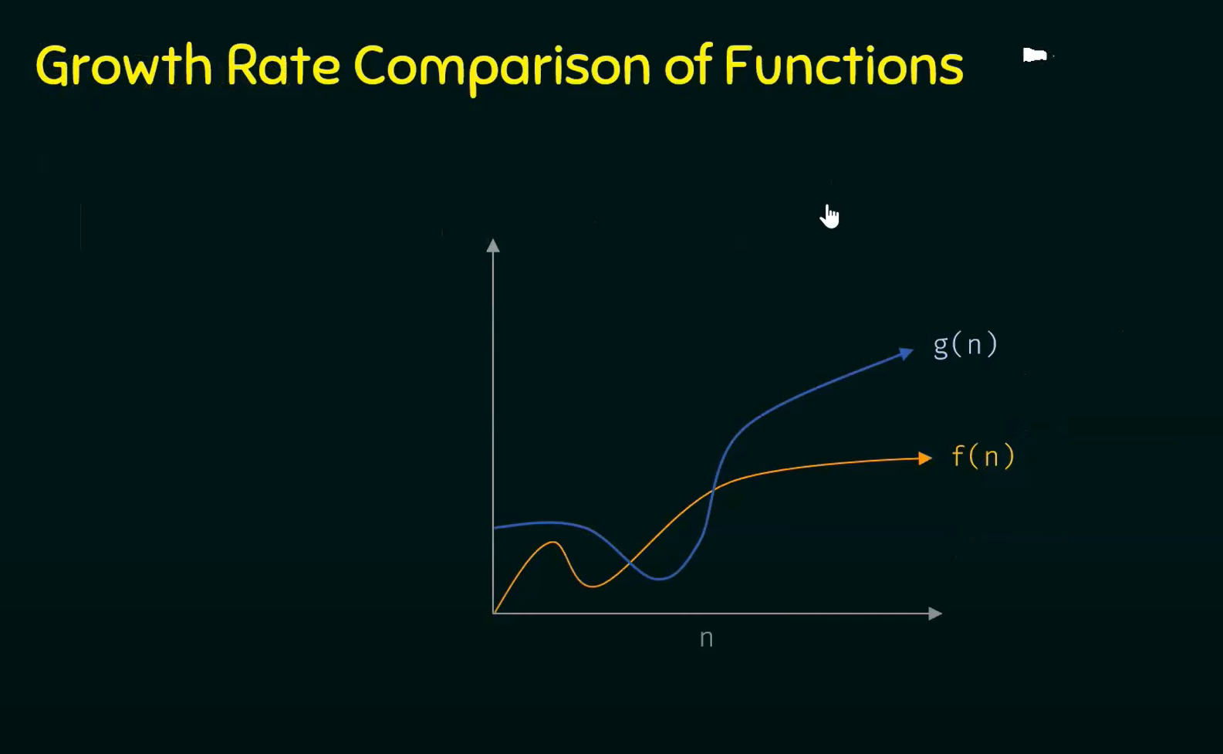

g(n) is asymptotically
bigger then f(n)
f(n)=O(g(n))

Slide 23
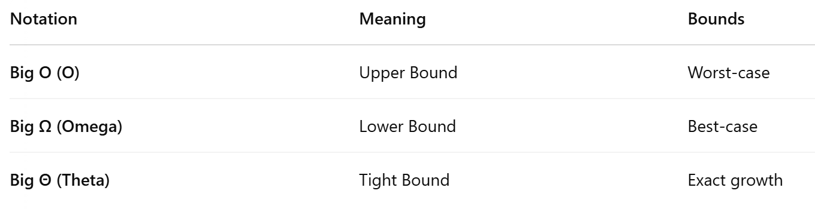
Asymptotic analysis
Asymptotic analysis is a mathematical way of describing how an algorithm performs as the input size (n) grows large. It gives a mathematical tool to compare algorithms independent of hardware, compilers, or programming language.
Main Asymptotic Notations:

Slide 24
Big O
Big O notation is a mathematical notation used in computer science to describe the upper bound or worst-case scenario of an algorithm's runtime complexity in terms of the input size. It provides a standardized and concise way to express how an algorithm's performance scales as the input size grows.
Big O gives the worst-case performance.
It defines the maximum amount of time an algorithm could take.

Slide 25
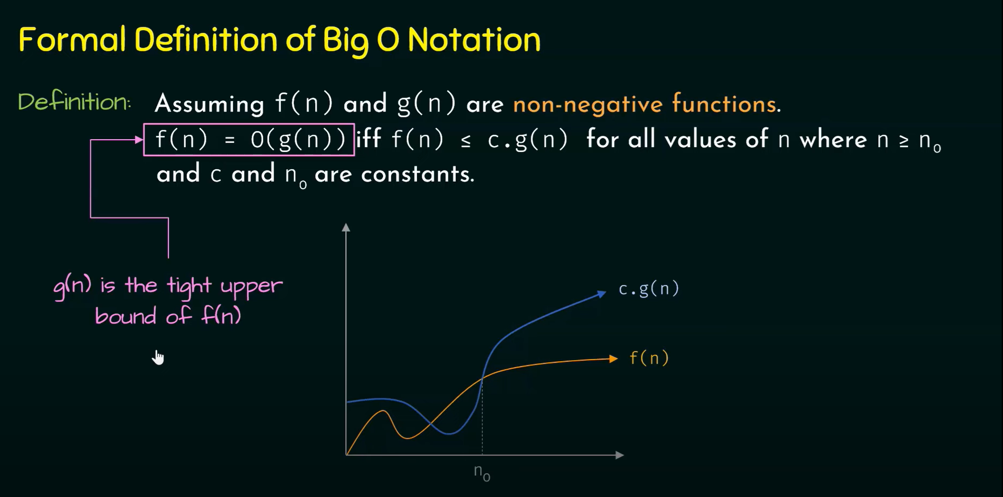

Slide 26
Problem 1: Assume that f(n)=5n+50 and g(n)=n. Is f(n)=O(g(n))?
Solution: According to the definition of Big O notation:
f (n)=O(g(n)) iff f(n) ≤ c.g(n) for all values of n where n ≥ n₀
and c and n₀ are constants.
Assuming c=6, why?
 | 5n+50 | 6n
n=10 | 100 | 60
n=20 | 150 | 120
n=50 | 300 | 300
n=50 | 305 | 306
5n+50=O(n)
for c=6 and n ≥ 50
tight upper bound

Slide 27
Problem 2: Assume that f(n)=5n+50 and g(n)= log₁₀n.
Is g(n) upper bound of f(n)?
Solution: According to the definition of Big O notation:
f (n)=O(g(n)) iff f(n) ≤ c.g(n) for all values of n where n ≥ n₀
and c and n₀ are constants.
Assuming c=1000
 | 5n+50 | 1000*log₁₀n
n=10 | 100 | 1000
n=10² | 550 | 2000
n=10³ | 5050 | 3000
n=10⁴ | 50050 | 4000
g(n) is not upper bound of f(n).

Slide 28
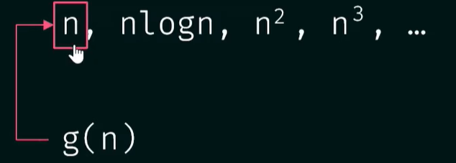
Problem 3: Find the upper bound of f(n)=3n+8.
Solution:
Step 1: identify the dominant term.
 | 3n | 8
n=10 | 30 | 8
n=20 | 300 | 8
n=50 | 3000 | 8
3n is the dominant term
Step 2: choose g(n) according to the dominant term.

Slide 29
Solution:
Step 3: Apply the Big O definition.
According to the definition of Big O notation:
f (n)=O(g(n)) iff f(n) ≤ c.g(n) for all values of n where n ≥ n₀
and c and n₀ are constants.
Assuming c = 4, why?
 | 3n+8 | 4n
n=7 | 29 | 28
n=8 | 32 | 32
n=9 | 35 | 36
n=100 | 308 | 400
3n+8 ≤ 4n ?
n₀
3n+8 ≤ 4n is true
∴ 3n+8 = O(n) for c = 4 and n₀=8

Slide 30
Problem 4: Find the upper bound of f(n) = n² + 10.
Solution:
Step 1: identify the dominant term.
 | n² | 10
n=10 | 100 | 10
n=100 | 10000 | 10
n=1000 | 1000000 | 10
n² is the dominant term
Step 2: choose g(n) according to the dominant term.
n² , n³ , 2^{n} , …
g(n)
Assuming c = 2, why?
n² + 10 ≤ 2n² ?
Step 3: Apply the Big O definition.
According to the definition of Big O notation:
f (n)=O(g(n)) iff f(n) ≤ c.g(n) for all values of n where n ≥ n₀
and c and n₀ are constants.

Slide 31
 | n² + 10 | 2n²
n=1 | 11 | 2
n=2 | 14 | 8
n=3 | 19 | 18
n=4 | 26 | 32
n² + 10 ≤ 2n² True
∴ n² + 10 = O(n²) for c = 2 and n₀=4
n₀

Slide 32
Problem 5: Find the upper bound of f(n) = 2n³ - 2n² .
Solution:
Step 1: identify the dominant term.
2n³ is the dominant term
Step 2: choose g(n) according to the dominant term.
Assuming c = 2, why?
2n³ - 2n² ≤ 2n³ ?
n³ , 2^{n} , …
g(n)
 | 2n³ - 2n² | 2n³
n=1 | 0 | 2
n=2 | 8 | 16
n=3 | 36 | 54
n=4 | 96 | 128
Step 3: Apply the Big O definition.
According to the definition of Big O notation:
f (n)=O(g(n)) iff f(n) ≤ c.g(n) for all values of n where n ≥ n₀
and c and n₀ are constants.
n₀
∴ 2n³ - 2n² = O(n³) for c = 2 and n₀=1
2n³ - 2n² ≤ 2n³ is true

Slide 33
Problem 6: Find the upper bound of f(n) = n⁴ + 100n² + 35.
Solution:
Step 1: identify the dominant term.
n⁴ is the dominant term
Step 2: choose g(n) according to the dominant term.
Assuming c = 2, why?
n⁴ + 100n² + 35 ≤ 2n⁴ ?
n⁴ , n⁵ ,2^{n} , …
g(n)
 | n⁴ + 100n² + 35 | 2n⁴
n=8 | 10531 | 8192
n=9 | 14696 | 13122
n=10 | 20035 | 20000
n=11 | 26776 | 29282
Step 3: Apply the Big O definition.
According to the definition of Big O notation:
f (n)=O(g(n)) iff f(n) ≤ c.g(n) for all values of n where n ≥ n₀
and c and n₀ are constants.
n₀
∴ n⁴ + 100n² + 35 = O(n⁴) for c = 2 and n₀=11
n⁴ + 100n² + 35 ≤ 2n⁴ is true

Slide 34
Problem 7: Find the upper bound of f(n) = 2^{n} + 3n³ .
Solution:
Step 1: identify the dominant term.
2^{n} is the dominant term
Step 2: choose g(n) according to the dominant term.
Assuming c = 2, why?
2^{n} + 3n³ ≤ 2^{n+1} ?
2^{n} , , …
g(n)
 | 2^{n} + 3n³ | 2^{n+1}
n=10 | 4024 | 2048
n=11 | 6041 | 4096
n=14 | 24616 | 32768
Step 3: Apply the Big O definition.
According to the definition of Big O notation:
f (n)=O(g(n)) iff f(n) ≤ c.g(n) for all values of n where n ≥ n₀
and c and n₀ are constants.
n₀
∴ 2^{n} + 3n³ = O(2^{n}) for c = 2 and n₀=14
2^{n} + 3n³ ≤ 2^{n+1} is true

Slide 35
Problem 7: Find the upper bound of f(n) = 300 .
Solution:
Step 1: identify the dominant term.
300 is the dominant term
Step 2: choose g(n) according to the dominant term.
Assuming c = 300, why?
300 ≤ 300.1 ?
1 , , …
g(n)
Step 3: Apply the Big O definition.
According to the definition of Big O notation:
f (n)=O(g(n)) iff f(n) ≤ c.g(n) for all values of n where n ≥ n₀
and c and n₀ are constants.
∴ 300 = O(1) for c = 300 and n₀=1
300 ≤ 300 is true

Slide 36
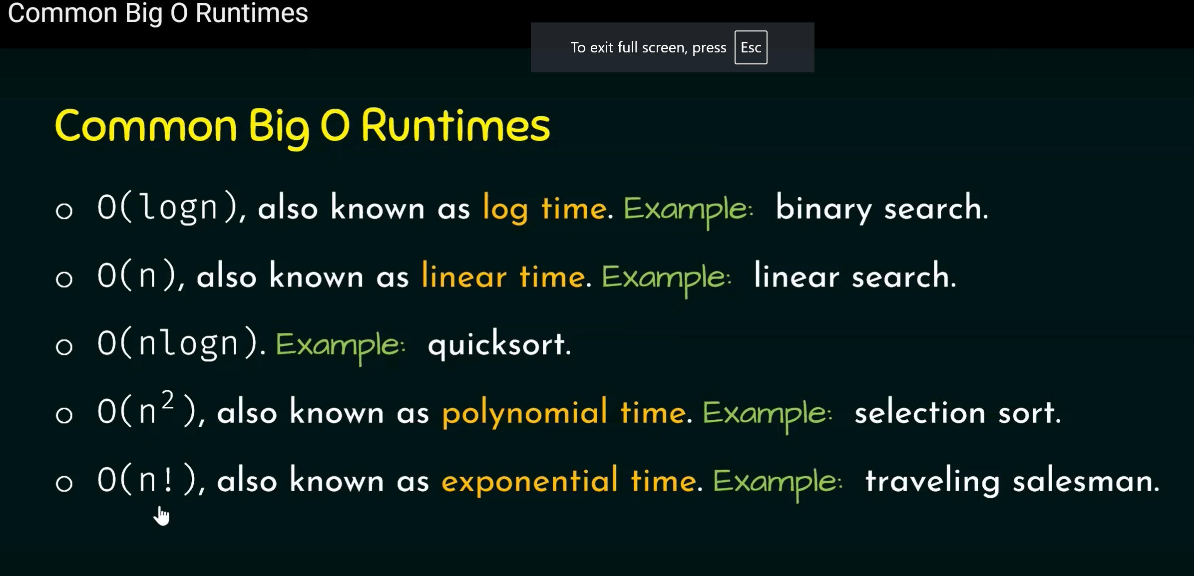
Common Big O Runtimes

Slide 37
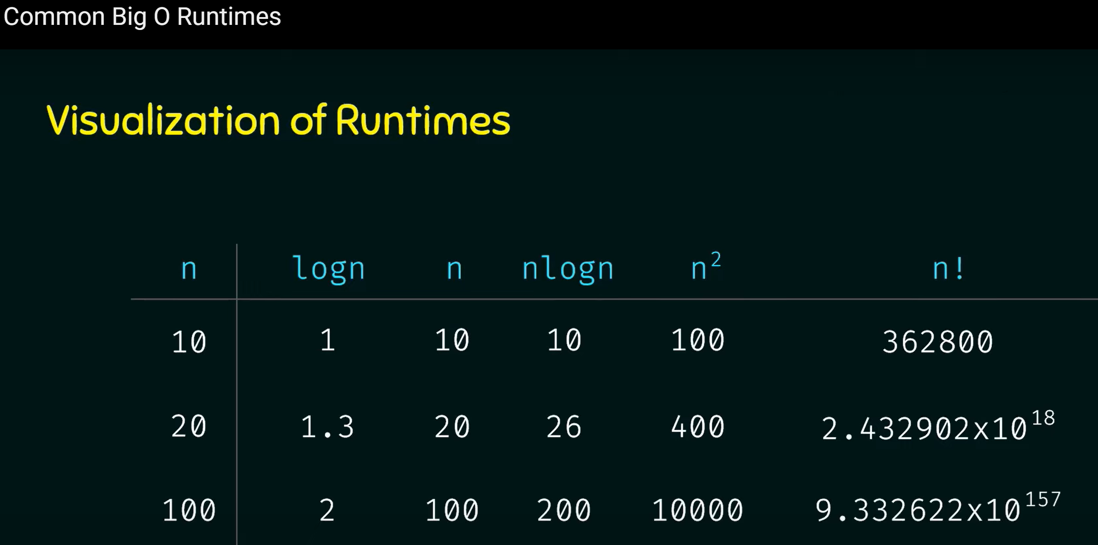

Slide 38
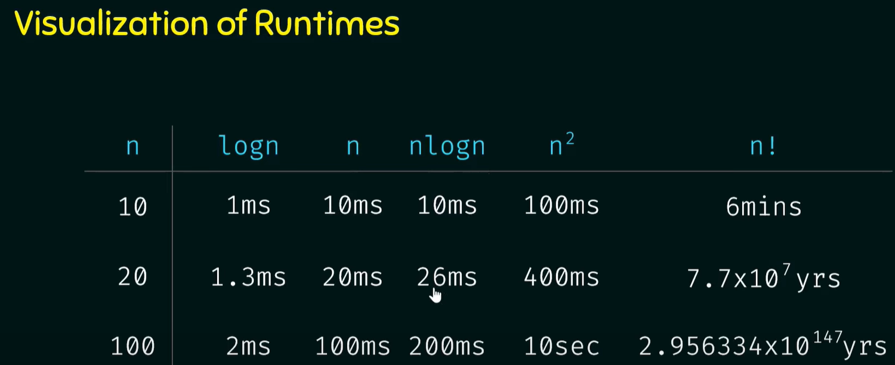

Slide 39
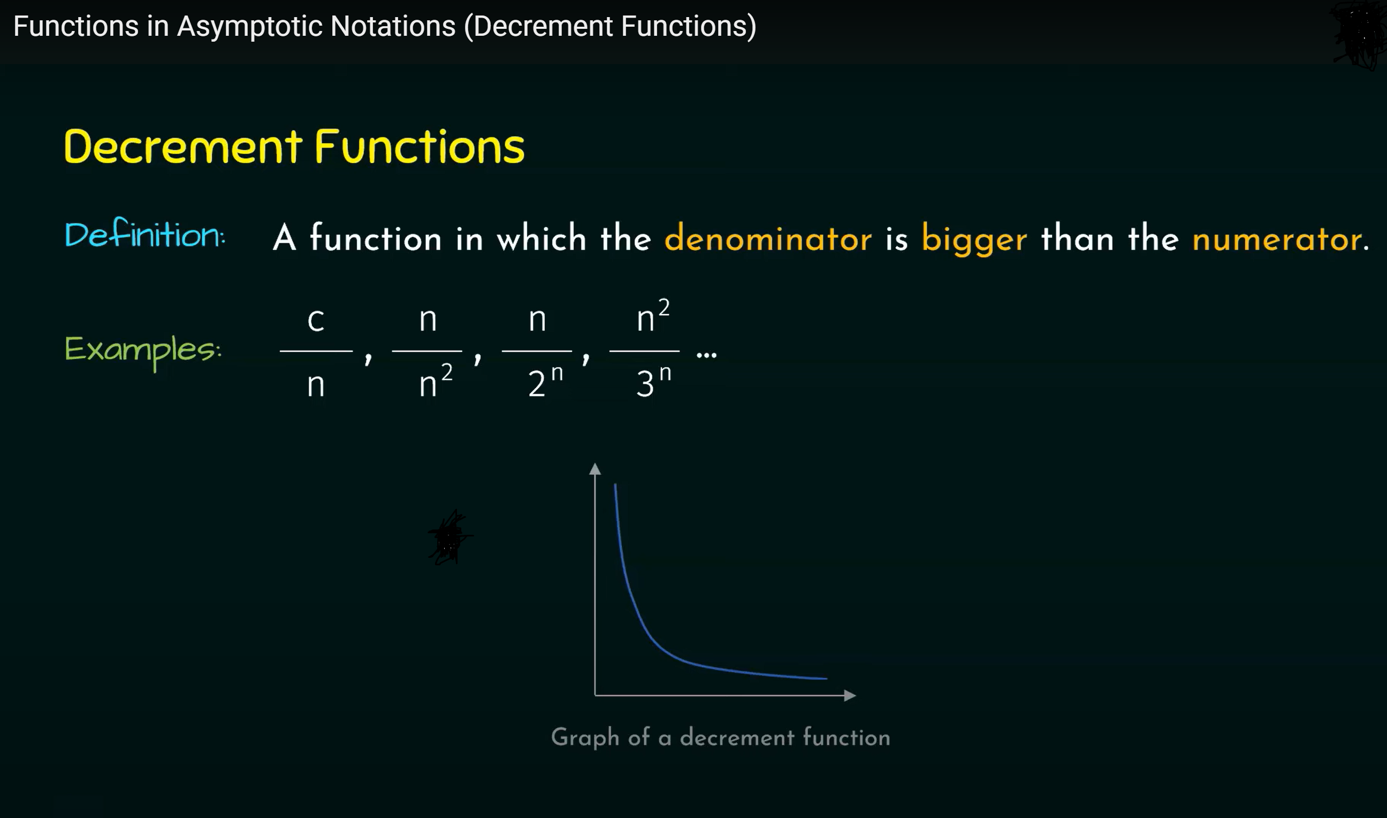

Slide 40
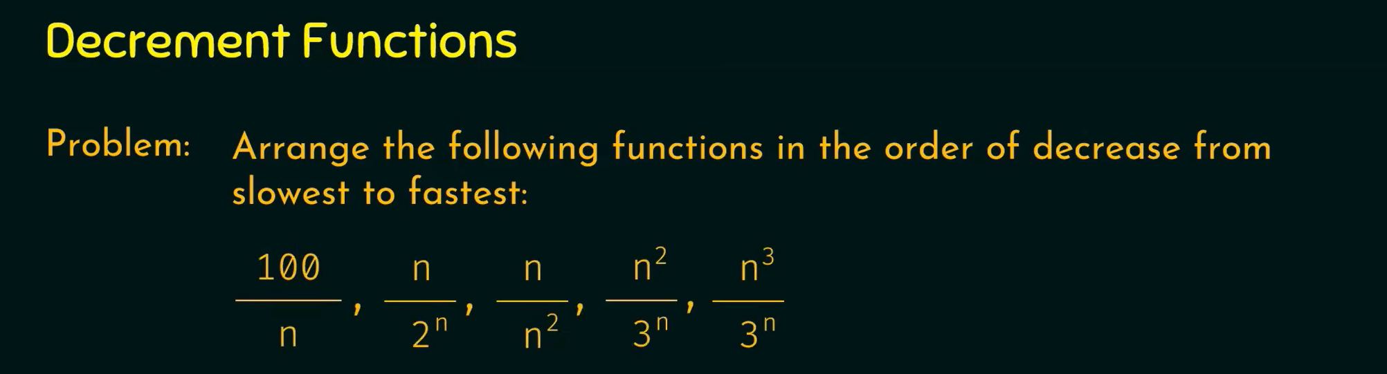
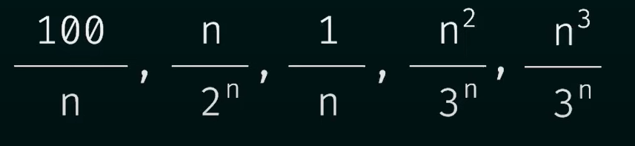
Solution:
Step1: Simplify the fractions

Slide 41
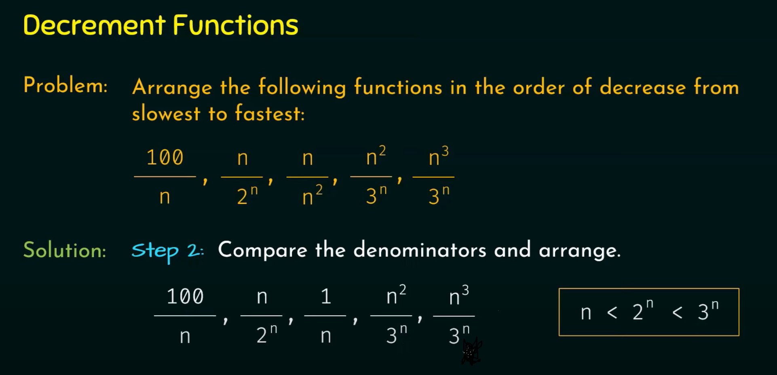
Step2: Compare the denominators and arrange

Slide 42
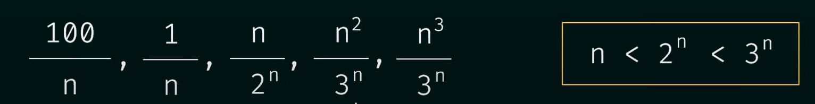
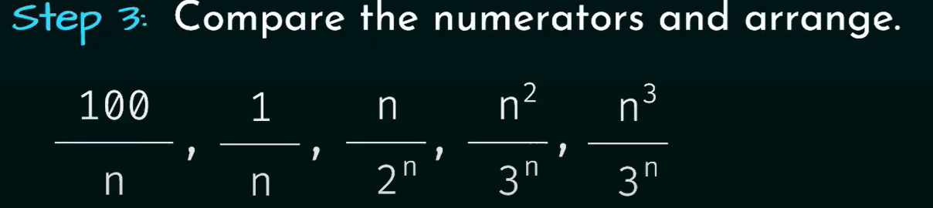
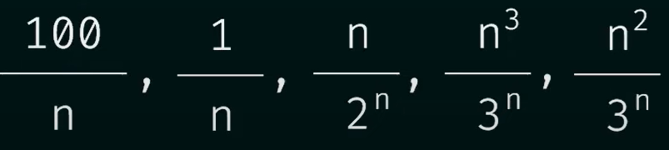

Slide 43
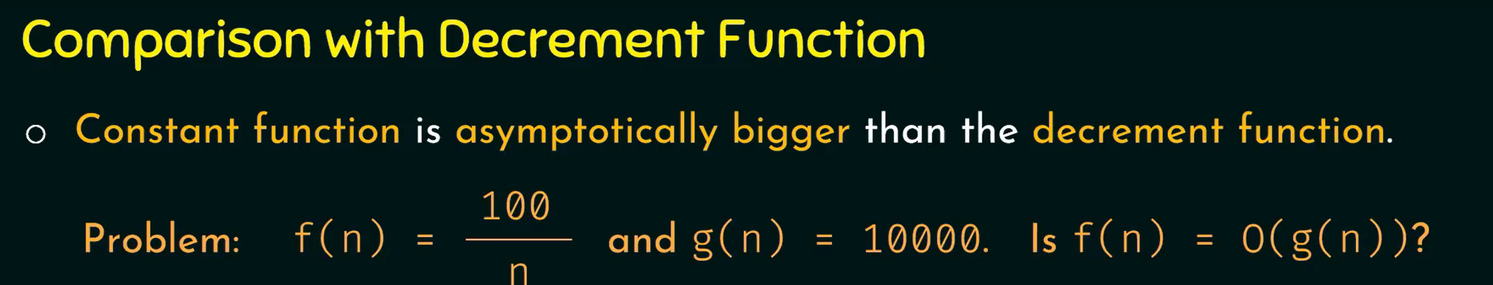
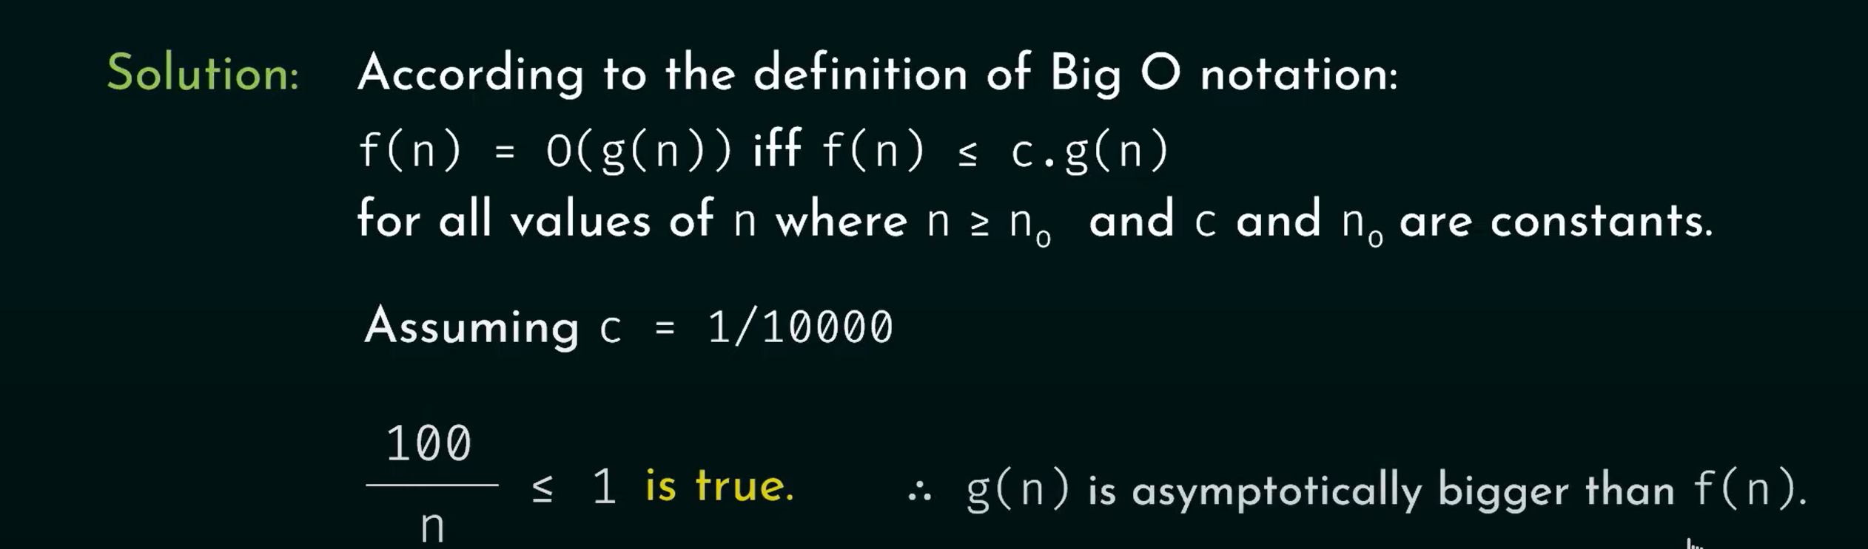

Slide 44
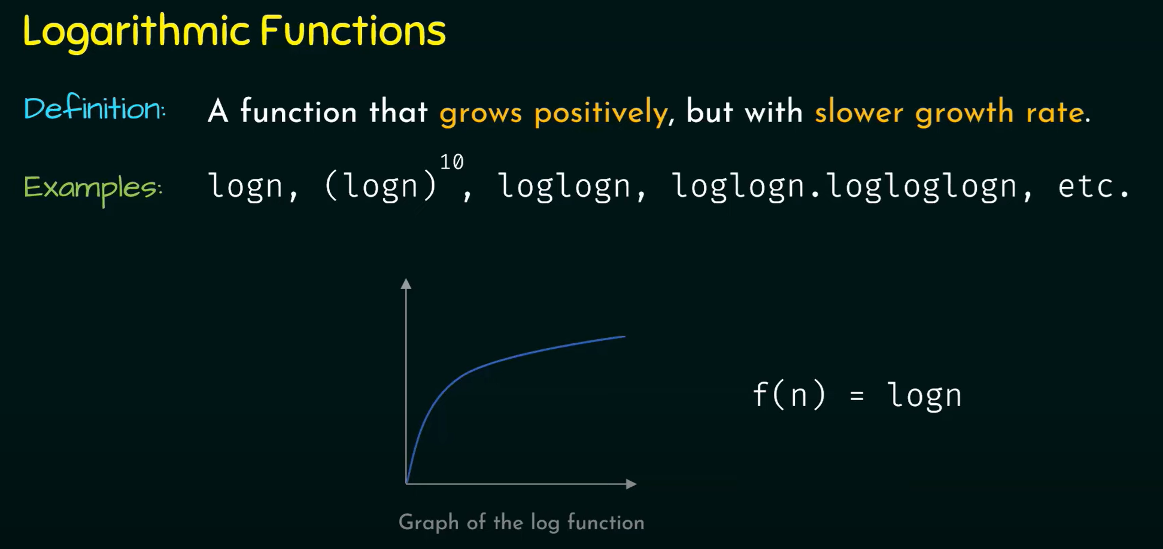

Slide 45
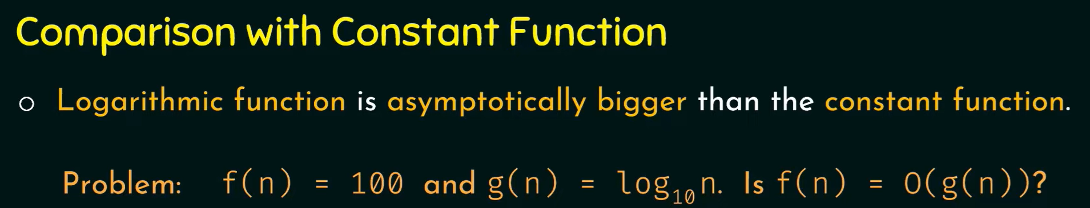
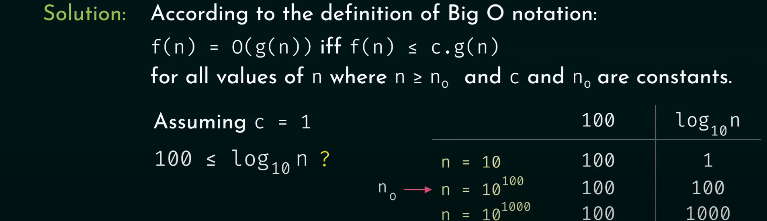

Slide 46
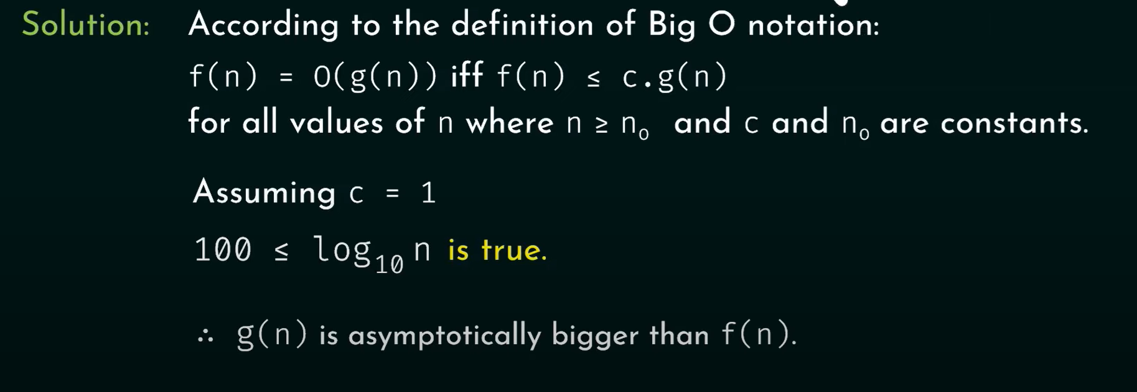

Slide 47
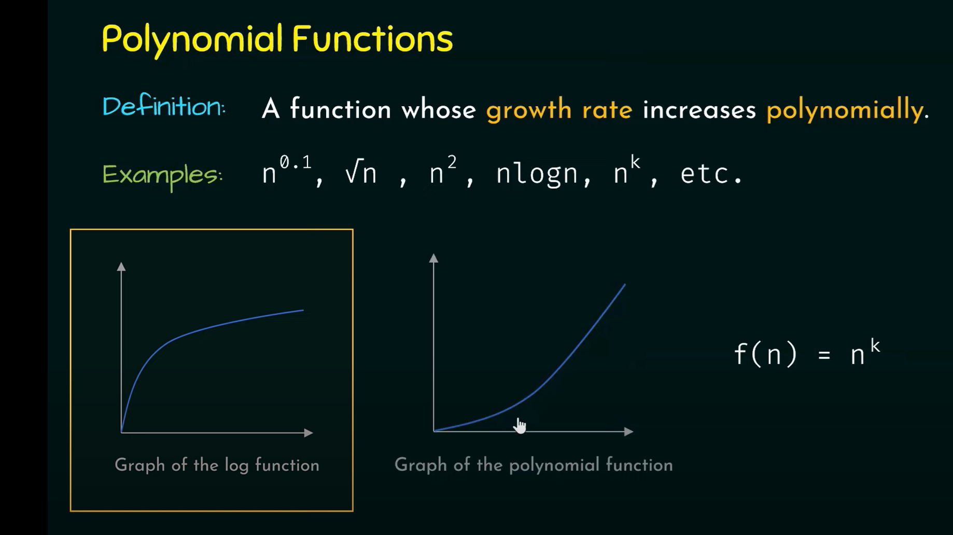

Slide 48
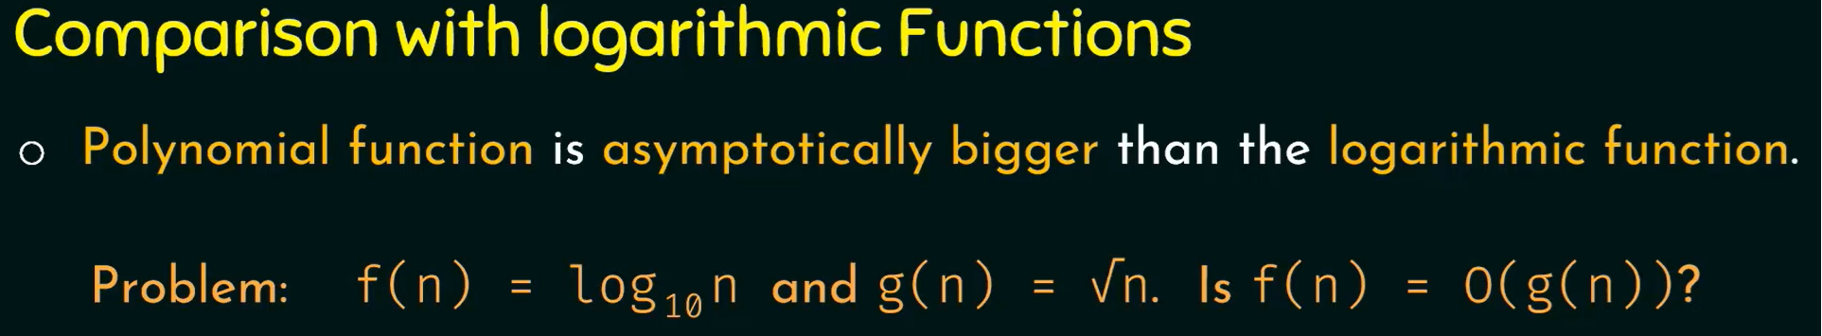
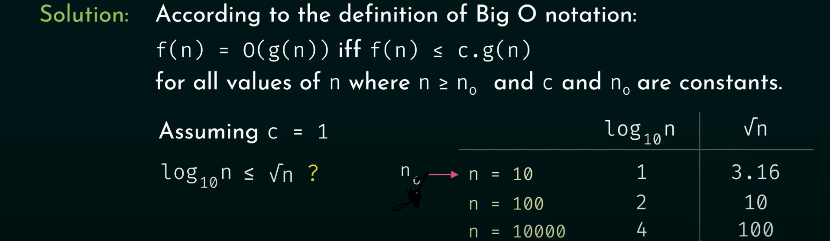

Slide 49
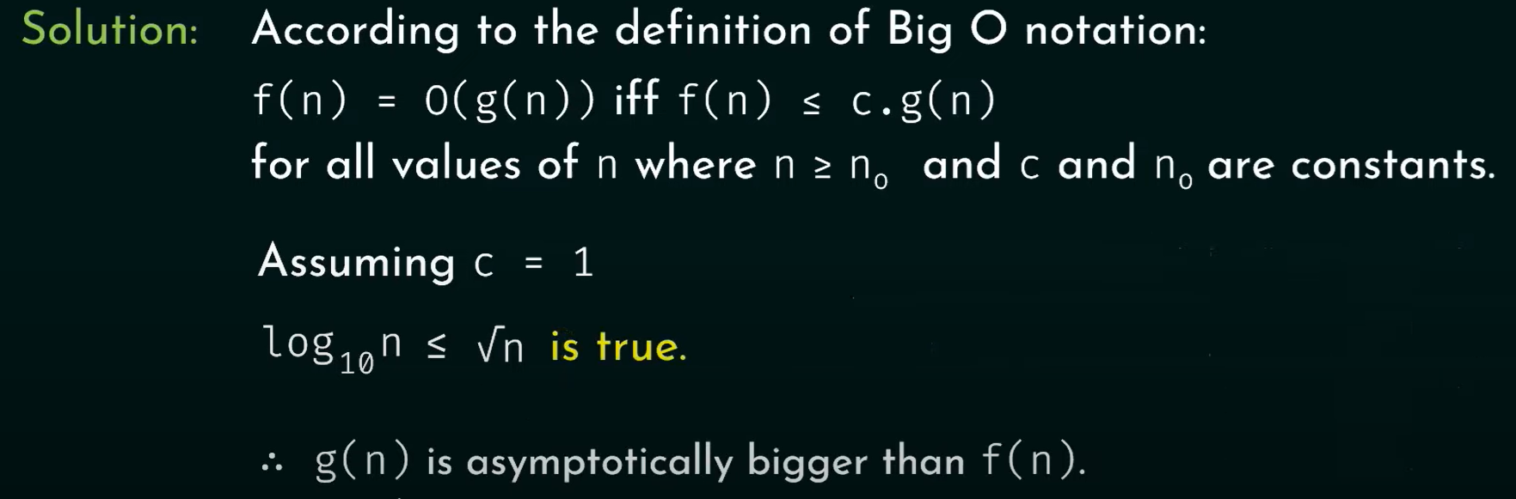

Slide 50
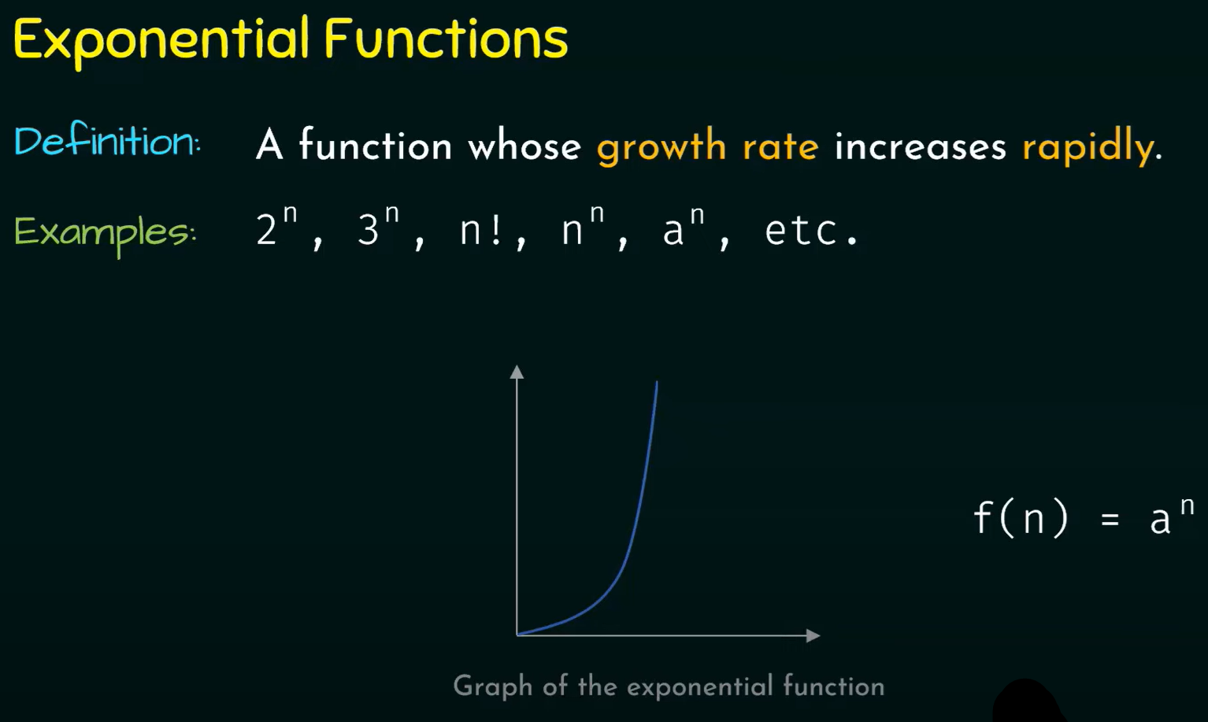

Slide 51
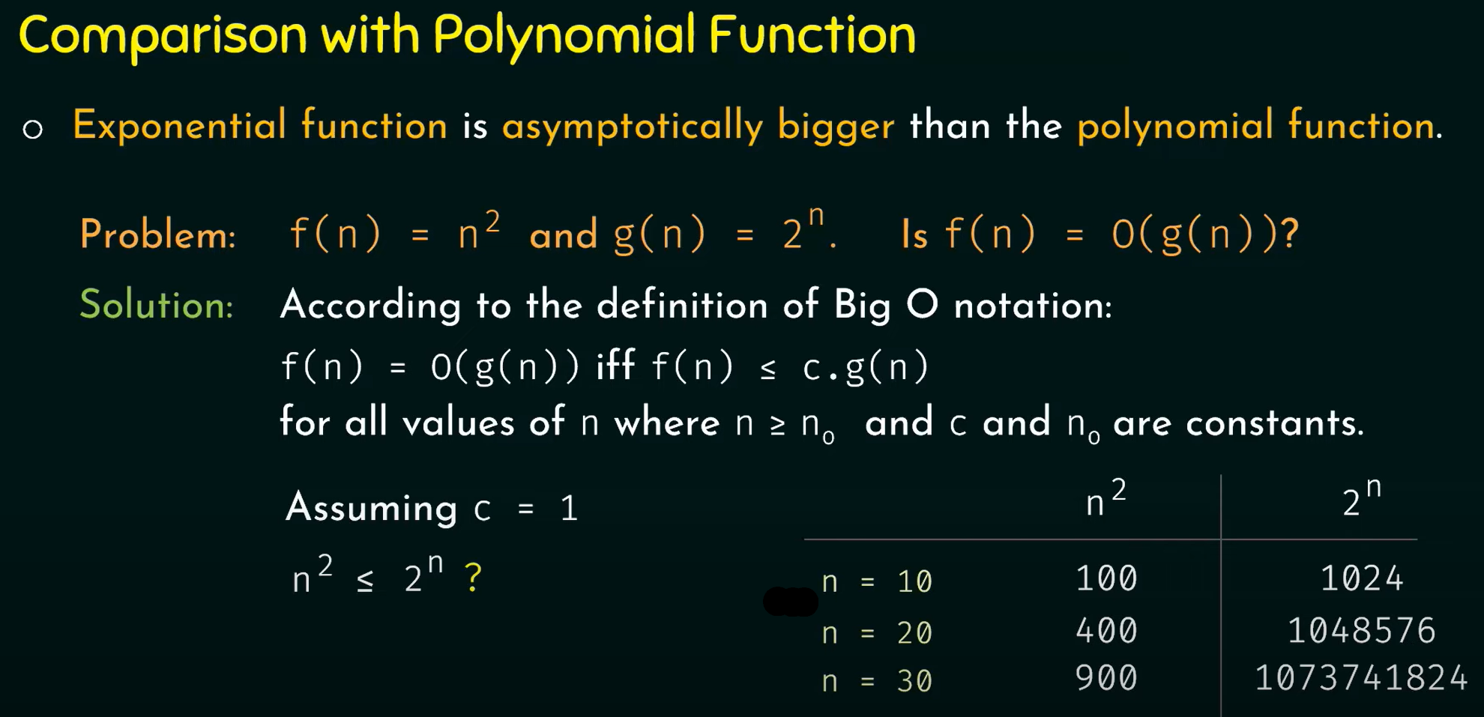

Slide 52
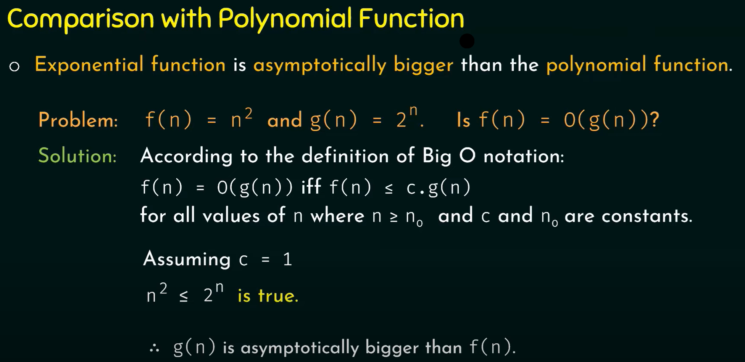

Slide 53
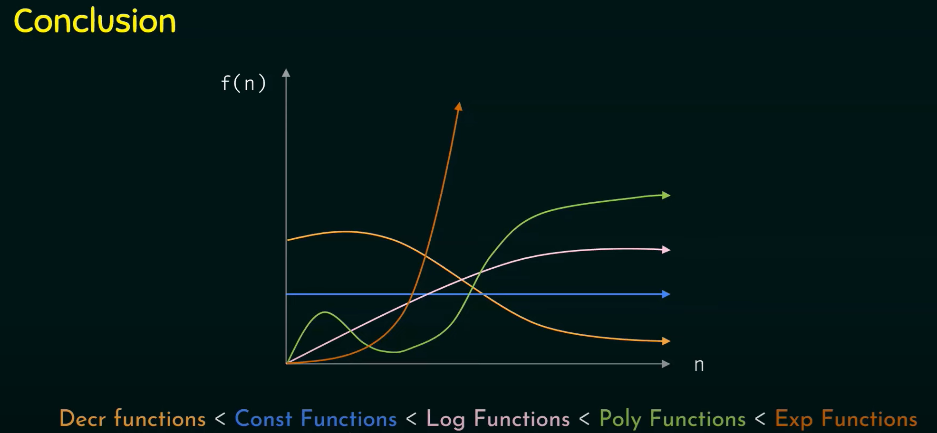

Slide 54
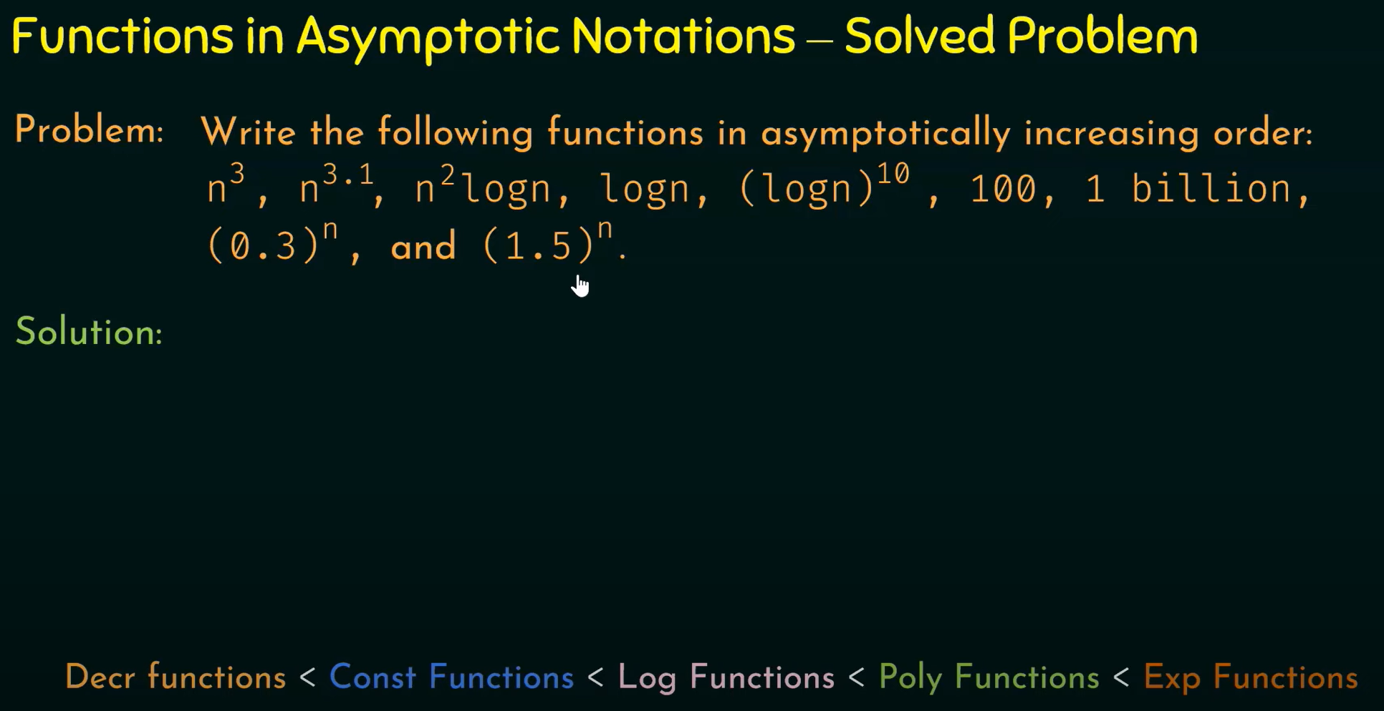

Slide 55
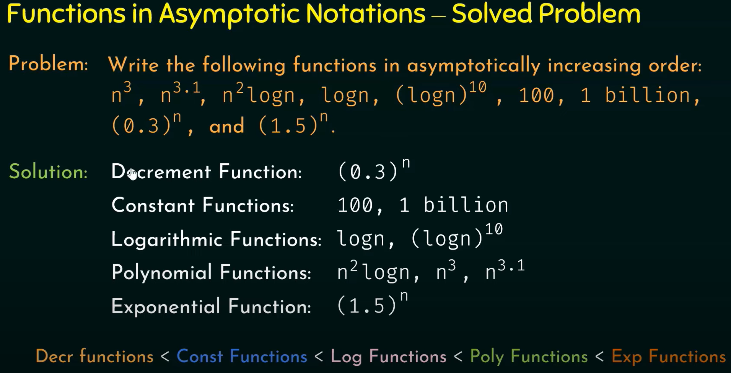

Slide 56
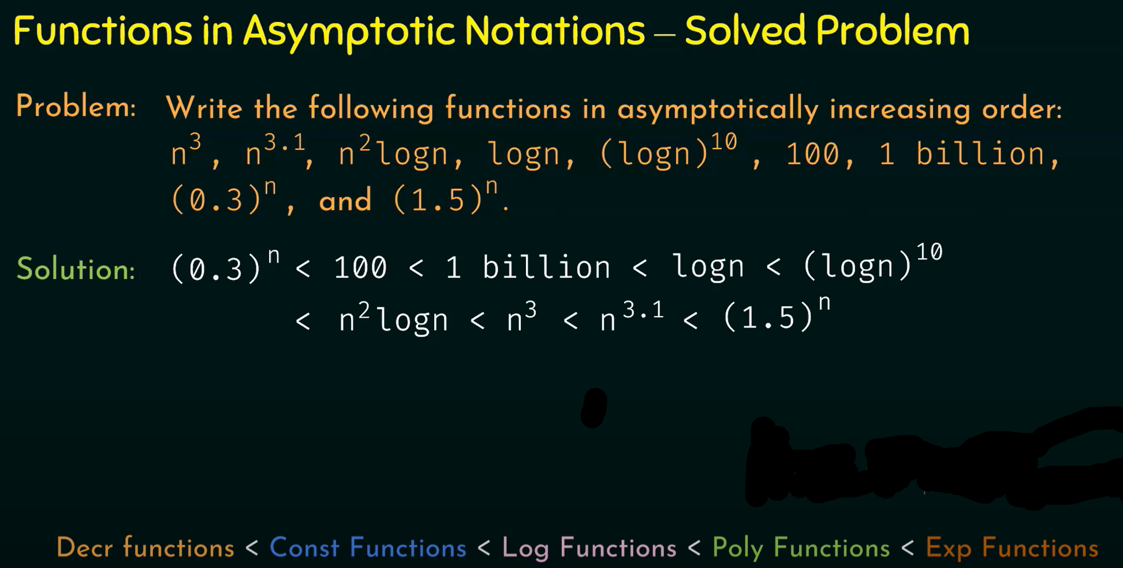

Slide 57
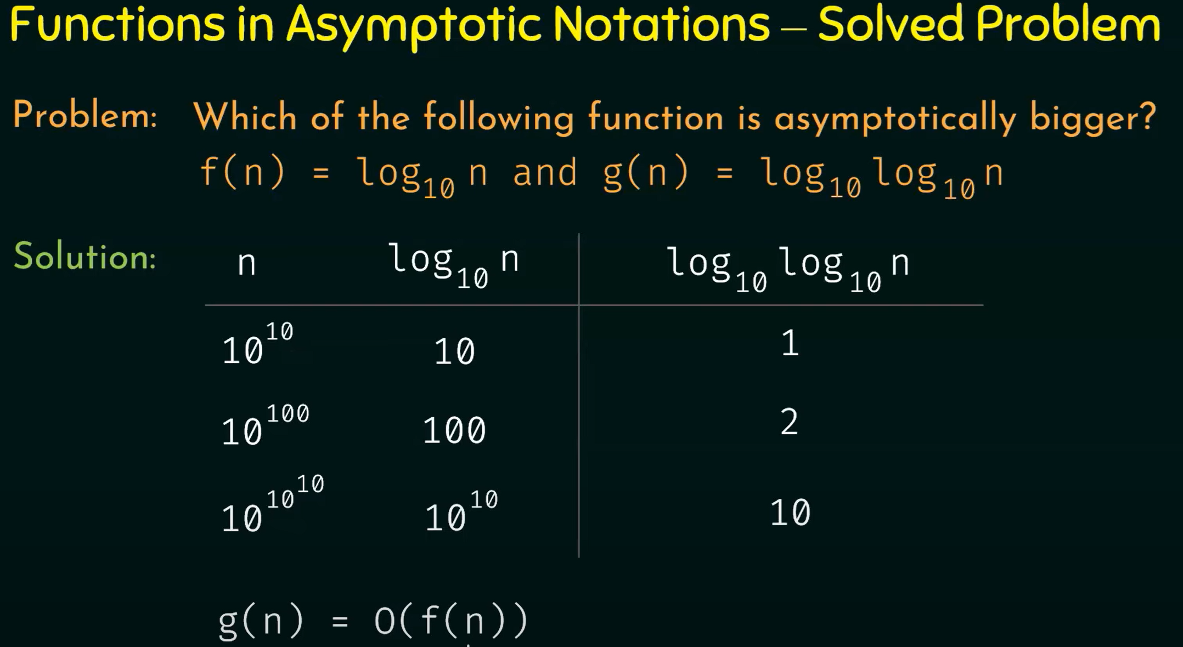

Slide 58


Slide 59

The Big Omega (Ω) Notation

Slide 60

The Big Omega (Ω) Notation

Slide 61

The Big Theta (θ) Notation

Slide 62
Big Omega (Solved Problems)
Problem: Find the lower bound for f(n)= 10n²+5
Solution: Step 1: Find the dominant term in f(n) is 10n²
Step 2: Assuming g(n) = n²
Step 3: According to the definition of Big Omega notation:
f(n) = Ω(g(n)) iff f(n) ≥ c.g(n) for so some c > 0 and for all values of n where n ≥ n₀ and c and n₀ are constants.
Assuming c=10, 10n² +5 ≥ 10n² ? is true for all n ≥ 1.
∴ 10n²+5= Ω(n²)for c=10 and n₀=1.

Slide 63
Big Theta Notations (Solved Problems)
Problem: Show that f(n)= n³+3n² = Ɵ(n³)
Solution: According to the definition of Big Theta notation:
f(n) = Ɵ(g(n)) iff c₁.g(n) ≤ f(n) ≤ c₂.g(n) for all values of n where n ≥ n₀ and c₁ ,c₂ , and n₀ are constants.
So, n₀=3
∴ n³+3n² = Ɵ(n³) for c₁ =1, c₂ =1 and n₀=3.
1. Let us prove f(n) ≤ c₂.g(n)
Assuming c₂= 2
n³+3n² ≤ 2 n³ ? is true for n ≥ 3.
2. Let us prove f(n) ≥ c₁.g(n)
Assuming c₁ =1 is true for n ≥ 1

Slide 64

Properties of Asymptotic Notations (General Property)

Slide 65

Properties of Asymptotic Notations (General Property)

Slide 66

Properties of Asymptotic Notations (General Property)

Slide 67

Properties of Asymptotic Notations (General Property)

Slide 68

Thank You!
End of Presentation
Questions?

